Slide 1




Module - 3
AI-Powered Text Generation Tools and its Integration

Slide 2

DISCLAIMER
The content is curated from online/offline resources and used for educational purpose only

Slide 3

Learning Objective
You will learn in this Chapter:
Apply modern web development skills using AI-assisted tools like GitHub Copilot and Cursor AI.
Enable rapid prototyping and data visualization through Streamlit for building interactive web applications.
Introduce AI integration techniques using tools like Gemini API for smart feature development (e.g., chatbots, content generation).
Develop proficiency in version control and cloud deployment using Git, GitHub, and Streamlit Community Cloud.
Empower learner to transfer industry-relevant skills to students, enhancing employability and innovation in academic projects.

Slide 4

Learning Outcome
You will learn in this Chapter:
Explain the purpose and key capabilities of the Gemini generative AI model and its API.
Create and manage API keys required for secure access to the Gemini API.
Install the Gemini Python client library and import it into a programming environment.
Configure an application by adding the API key securely for authenticated communication with Gemini services.
Formulate and send well‑structured text queries (prompts) to the Gemini model using the client library.
Generate, retrieve, and interpret text responses returned by the Gemini API for integration into applications.

Slide 5

Integration of Gemini
Introduction
Gemini API acts as a bridge between applications and generative AI models.
It enables applications to create text responses from prompts.
Developers and teachers can build tools that generate explanations, answers, summaries, and outlines.
Integration involves sending a prompt to Gemini through the API and receiving an AI-generated response.
This process reduces the need to write all content manually.
Source :
https://www.gstatic.com/lamda/images/gemini_aurora_thumbnail_4g_e74822ff0ca4259beb718.png
Notes:
The Gemini API allows developers and educators to connect their applications with a generative AI model that can process prompts and produce meaningful text. When an application integrates Gemini, it does not have to rely entirely on manually written content. Instead, the system can send a specific query or instruction as a prompt, and the Gemini model processes this prompt to produce a relevant response. For example, a faculty member who is preparing lesson content for a subject can use Gemini to generate summaries of a concept, draft explanations for key topics, or even produce a list of key points for a class discussion. Similarly, a developer can integrate this API into an educational platform so that when a student asks a question about a topic, the platform can automatically produce a well-structured response using Gemini. The entire process works in real time, ensuring that the application behaves intelligently without requiring the developer or teacher to write every answer in advance.

Slide 6


Integration of Gemini
Introduction
Gemini is a generative AI model that produces responses from text prompts.
The Gemini API enables smooth communication between software and the AI model.
The interaction is a request-response process where prompts are sent and answers are received.
Analogy: Like inviting an expert guest to answer questions during a seminar.
Source :
https://www.gstatic.com/lamda/images/gemini_aurora_thumbnail_4g_e74822ff0ca4259beb718.png
Notes:
Gemini is designed to understand text-based instructions and generate meaningful responses. The model works through an API that acts as a bridge between your software and the model itself. The way it works is very straightforward. First, the application sends a request known as a prompt. The Gemini model processes this prompt and sends back a response that the application can display or use. This can be compared to a seminar where a faculty member invites a guest expert to address questions from the audience. Instead of answering every question personally, the faculty member asks the expert, who then shares the answer. In the same way, your application sends the question to Gemini through the API and displays the answer that comes back. In real-world educational scenarios, this makes it possible to quickly generate practice questions, provide explanations to students instantly, or prepare summaries for topics without having to manually prepare each one in advance.

Slide 7

Integration of Gemini
Creating an API Key
An API key is required to use the Gemini API.
The key verifies identity and authorizes requests.
Steps to create an API key:
Sign up on the Gemini platform - https://gemini.google.com/app
Now navigate to - https://ai.google.dev/gemini-api/docs
Notes:
To use the Gemini API, the first step is to create an API key.
This key acts as a unique identifier that allows the platform to confirm that the requests are coming from you.
Without this key, your software will not be able to communicate with the Gemini model.
The process of generating this key is simple.
After creating an account on the Gemini platform, you need to visit the documentation page where you will find instructions for generating the key.

Slide 8
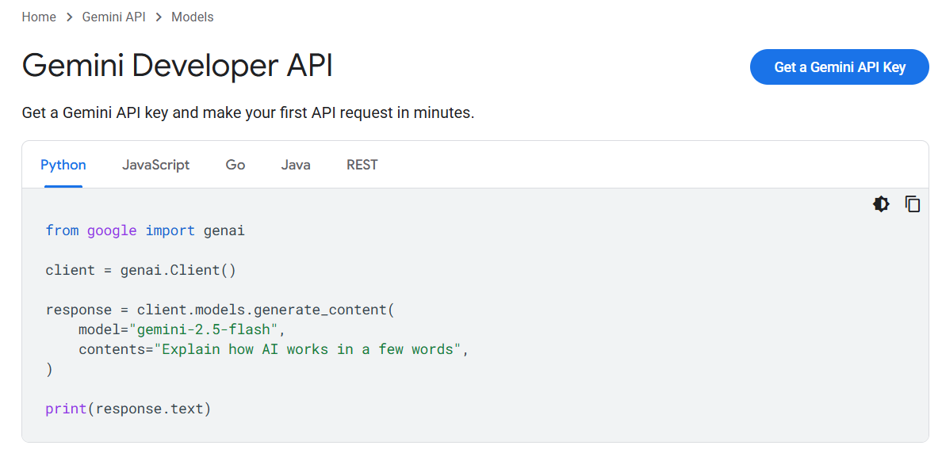
Integration of Gemini
Creating an API Key
Steps to create an API key:
Locate the option to get a Gemini API key.
Source :
Screenshot
Notes:
By clicking the option to get a new key, the system will provide you with a long combination of letters and numbers.

Slide 9
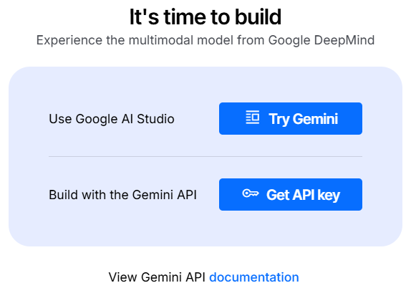
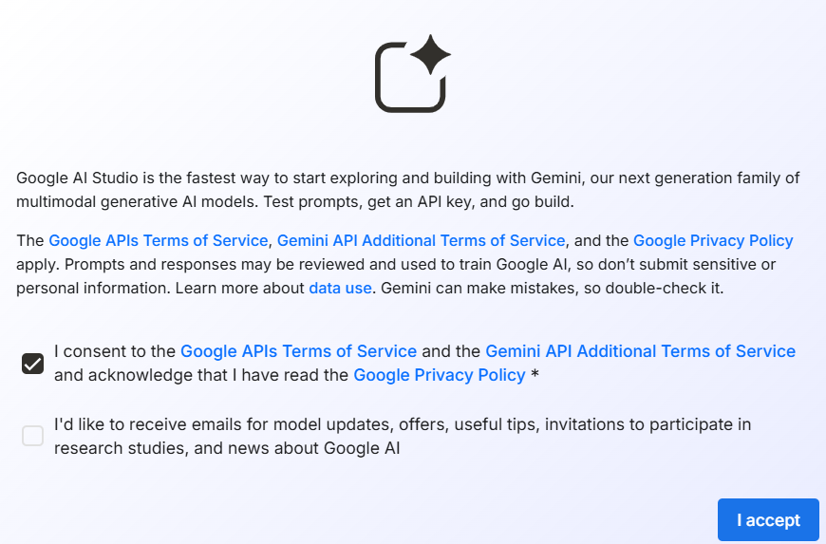
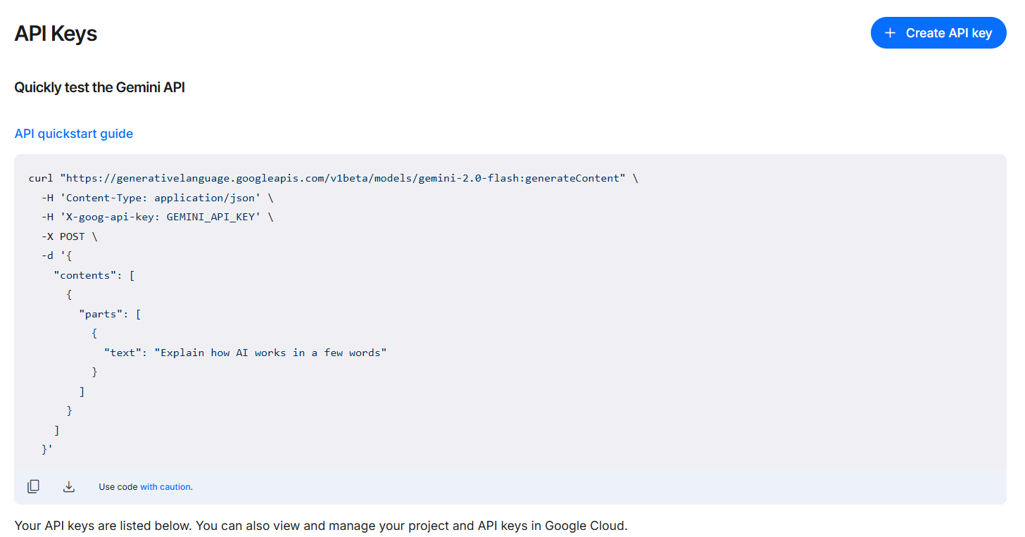
Integration of Gemini
Creating an API Key
Generate a new key from the interface.
Source :
Screenshots
Notes:
Follow these steps to generate and get the key. This is your API key, and it is important to copy it and store it safely.

Slide 10
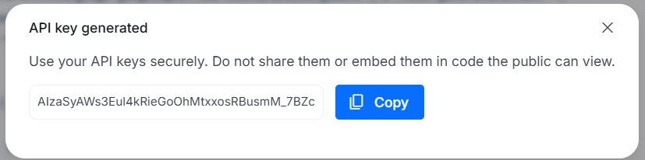
Integration of Gemini
Creating an API Key
Copy and store the key securely without sharing it publicly.
Analogy: Similar to a digital ID card that gives access to a restricted research lab.
Source :
Screenshot
Notes:
The key should be kept confidential because anyone who has access to it can make requests that will be counted under your usage.
This can be compared to how a research lab uses ID cards. Only those with valid cards can enter and access the facilities. Similarly, the Gemini API key acts like a digital entry pass. Without this key, the system will not allow your application to interact with Gemini.

Slide 11
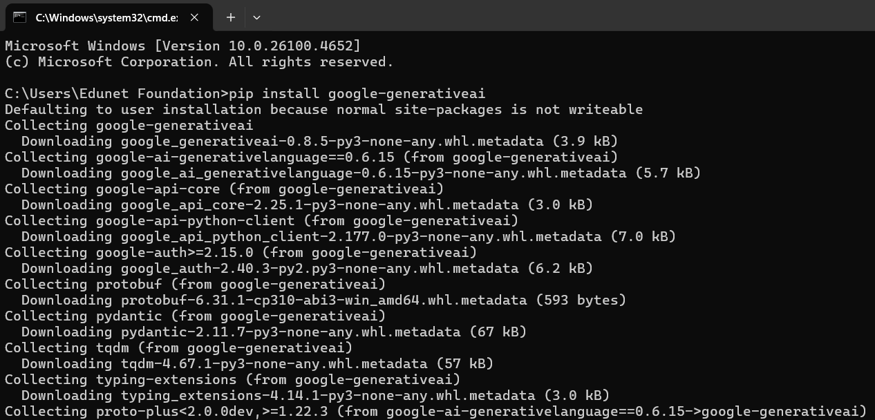
Integration of Gemini
Installing and Importing Gemini Library
Gemini library helps in using the API without writing all network request code.
Steps to install and import in Python:
Open your coding environment such as IDE, Command Prompt or terminal.
Run command: pip install google-generativeai.
Source :
Screenshot
Notes:
To work with Gemini more efficiently, a ready-made programming library is provided. Without such a library, a developer would need to manually write network request code, handle responses, and manage the entire connection process. The library makes this process simple by providing pre-built functions.
The steps are straightforward. You first open your coding environment, which can be an Integrated Development Environment, a command prompt, or a simple terminal. Then you use the package manager to install the library.
For example, in Python, the command is pip install google-generativeai.

Slide 12
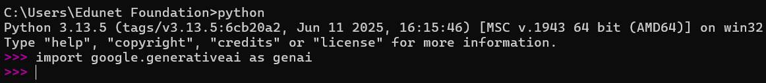
Integration of Gemini
Installing and Importing Gemini Library
Verify installation by checking for errors.
Import in code using: import google.generativeai as genai.
Analogy: Using the library is like using ready-made teaching aids instead of creating everything from scratch.
Source :
Screenshot
Notes:
After the installation, it is important to check that the process completes without showing errors.
Once this is done, the library is ready to use in your code.
You can import it into a Python program by using the line import google.generativeai as genai.
This step can be compared to a teacher using ready-made teaching aids in a classroom. Instead of spending time creating every chart, diagram, or model from scratch, the teacher uses these ready-made resources to save time and effort. Similarly, the library provides all the essential tools needed to communicate with Gemini without having to manually build everything.

Slide 13

Integration of Gemini
Adding API Key
The library requires an API key for authentication.
Without the API key, requests to Gemini will not be processed.
Steps to add an API key:
Store the key securely, preferably in an environment variable.
Access the key in code. Directly pasting it is possible but not recommended.
Configure the library to use the key.
Example in Python: genai.configure(api_key="YOUR_API_KEY").
Source :
Icon
Notes:
Once the Gemini library is installed, it cannot work unless the system knows that the request is coming from an authorized user. This is why adding an API key is essential. The API key acts as a pass that proves your identity to the Gemini system. Without this key, no request will be accepted or processed.
The preferred way to store the API key is by placing it in an environment variable. This keeps the key separate from your program code. It is like keeping an ID card in a safe place such as a wallet rather than leaving it on a desk where others can pick it up. When the program runs, it can access the key from the environment variable without revealing it inside the code.
Another way is to directly paste the key in the program code. While this is simpler during testing, it is not a safe practice for actual projects because if the code is shared, the key becomes visible to everyone. After storing or accessing the key, the next step is to configure the Gemini library to use it.
In Python, this is done using the line genai.configure(api_key="YOUR_API_KEY").

Slide 14
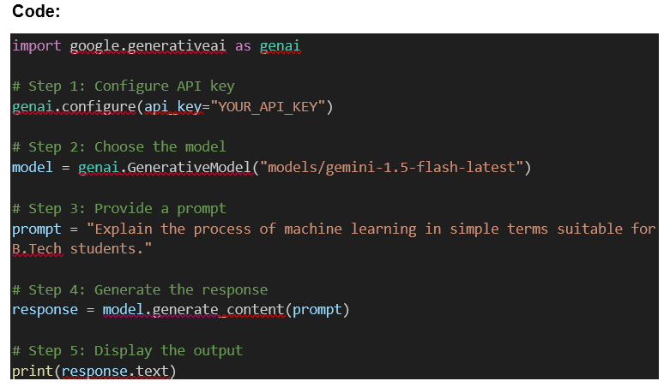
Integration of Gemini
Adding a Query
After authentication, prompts can be sent to Gemini.
Steps to add a query:
Decide the task clearly such as summary, explanation, story, or structured data.
Frame the query in a clear and specific way.
Use the library function to send the prompt to the model.
Gemini processes the prompt and returns a generated response.
Source :
Screenshot
Notes:
Once the API key has been configured, the program is ready to interact with the Gemini model. The interaction begins by sending a prompt. Before writing a prompt, it is important to think carefully about the purpose of the request. The purpose could be to generate a short summary, an explanation of a concept, a creative paragraph, or a structured output like a list or table.
The second step is framing the query clearly. A prompt that is vague will give results that are not useful. A clear and specific prompt helps the model to focus on the exact requirement. For example, instead of saying “Write something about programming,” a more specific prompt can be “Write a simple explanation of loops in programming for first-year students.” The third step is to use the functions provided by the Gemini library to send the prompt. These functions take the prompt text, communicate with the Gemini model, and return a response.
When the response comes back, it can be displayed, stored, or processed by the application. For instance, a faculty member preparing a class on sorting algorithms can send a prompt asking for a step-by-step explanation in simple language. The application connected to Gemini will receive a clear explanation that can be directly shown to students or adapted for teaching materials. Similarly, an application could take a question typed by a student and send it to Gemini to generate an instant answer.

Slide 15
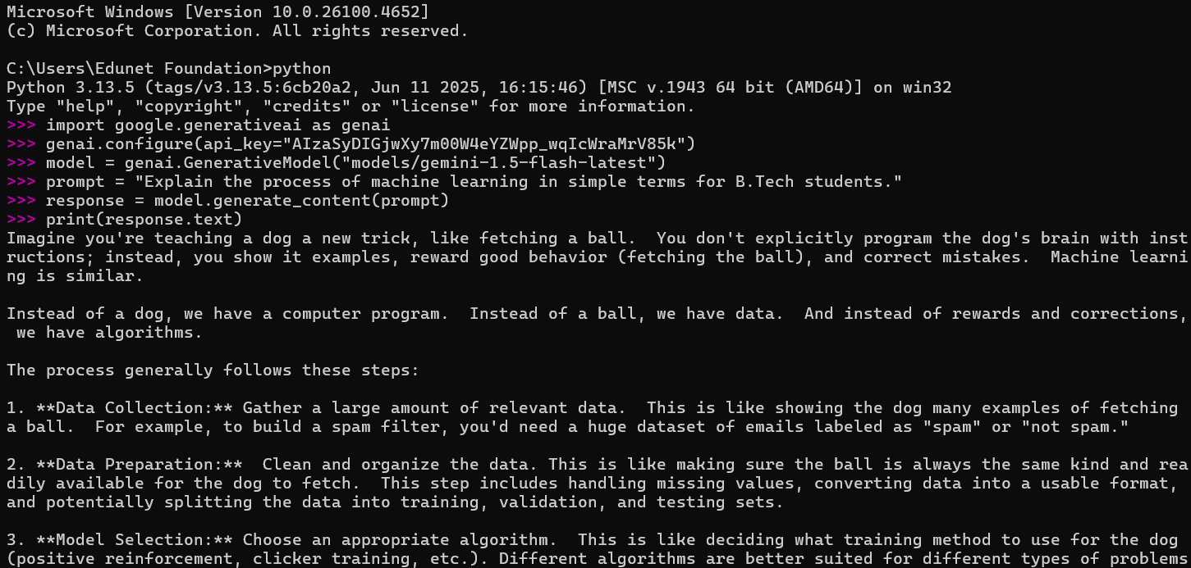
Integration of Gemini
Generating Text Response
Gemini processes the prompt and sends back a response.
Steps to handle the response:
Access the text from the response object.
Display, use, or store the text in the required format.
Post-process the text if formatting or further handling is required.
Source :
Place your source text here
Notes:
After a query is sent to the Gemini model, the system processes it and generates a response. This response is returned to the program as an object that contains the text output. The first step is to access the text part of this response object. Depending on the programming language, this involves reading a specific attribute or method of the response object.
Once the content has been accessed, the next step is to decide how to use it. For example, the response can be directly printed on the screen during development to verify the result. In a more advanced application, the response can be shown as part of a web page, used in a chatbot interface, or saved into a file for later use. This allows flexibility in how the output is consumed by the end user.
The last step is post-processing if necessary. Sometimes the generated text may require formatting before it is shown to students or stored.

Slide 16

Lab Activity
Lab 1 - Text Generation app via Gemini API Integration

Slide 17

Summary
You will learn in this Chapter:
How Gemini API connects applications with AI models.
How to create and use an API key for authentication.
How to install and import the Gemini library.
How to configure the Gemini library with the API key.
How to send clear prompts to get responses.
How to use, display, or process the responses.

Slide 18
Reference
About Gemini. (n.d.). Learn about Gemini, the everyday AI assistant from Google. Gemini. https://gemini.google/about/
Caballar, R., & Stryker, C. (2025, June 3). Google Gemini. What is Google Gemini? https://www.ibm.com/think/topics/google-gemini
Pichai, S. (2024, September 27). Introducing Gemini: our largest and most capable AI model. Google. https://blog.google/technology/ai/google-gemini-ai/

Slide 19





Slide 20

Quiz
What is the primary focus of this module?
Offline Storage Management
Data Visualization
AI-Powered Text Generation and its Integration
Web Application Security
Answer: C
AI-Powered Text Generation and its Integration

Slide 21
Quiz
In the context of Gemini, what is a 'prompt'?
API Key
Well-structured text query
User Profile
A kind of virus
Answer: B
Well-structure text query

Slide 22
Quiz
What does the Gemini API require for every request?
API key
Date of request
Encryption key
User’s email
Answer: A
API key

Slide 23
Quiz
When using Gemini in production, it is best to:
Print the API key
Store the key in public code
Keep API keys in environment variables
E-mail the key to developers
Answer: C
Keep API keys in environment variables

Slide 24
Quiz
What does an API key facilitate when using Gemini services?
Secure and authenticated API access
Local database management
Internet speed boost
Data visualization
Answer: A
Secure and authenticated API access

Slide 25
Thank You

